Slide 1


Enhancing the Privacy and Utility of Synthetic Datasets with Generative Machine Learning
Thesis Presentation, 20th January 2025
Zehao Zhang
zehao.zhang@uzh.ch
Supervised by
Weijie Niu,
Dr. Alberto Huertas Celdran
Notes:
Good afternoon everyone, and nice to see some of you again after 3 months. My name is Zehao Zhang and the topic of my thesis is enhancing the ….. With GML. I would like to express my great thanks to Weijie and Alberto for all the guidance.

Slide 2
Table of Contents
INTRODUCTION & RECAP
METHODOLOGY
EXPERIMENTS & EVALUATION
DISCUSSION
CONCLUSION & FUTURE WORK
Notes:
"Here is the structure of today’s presentation. I will start with an introduction and a brief recap of relevant concepts, followed by the methodology and evaluation framework. Then, I will present the results and key findings, discuss their implications, and conclude with future directions."

Slide 3
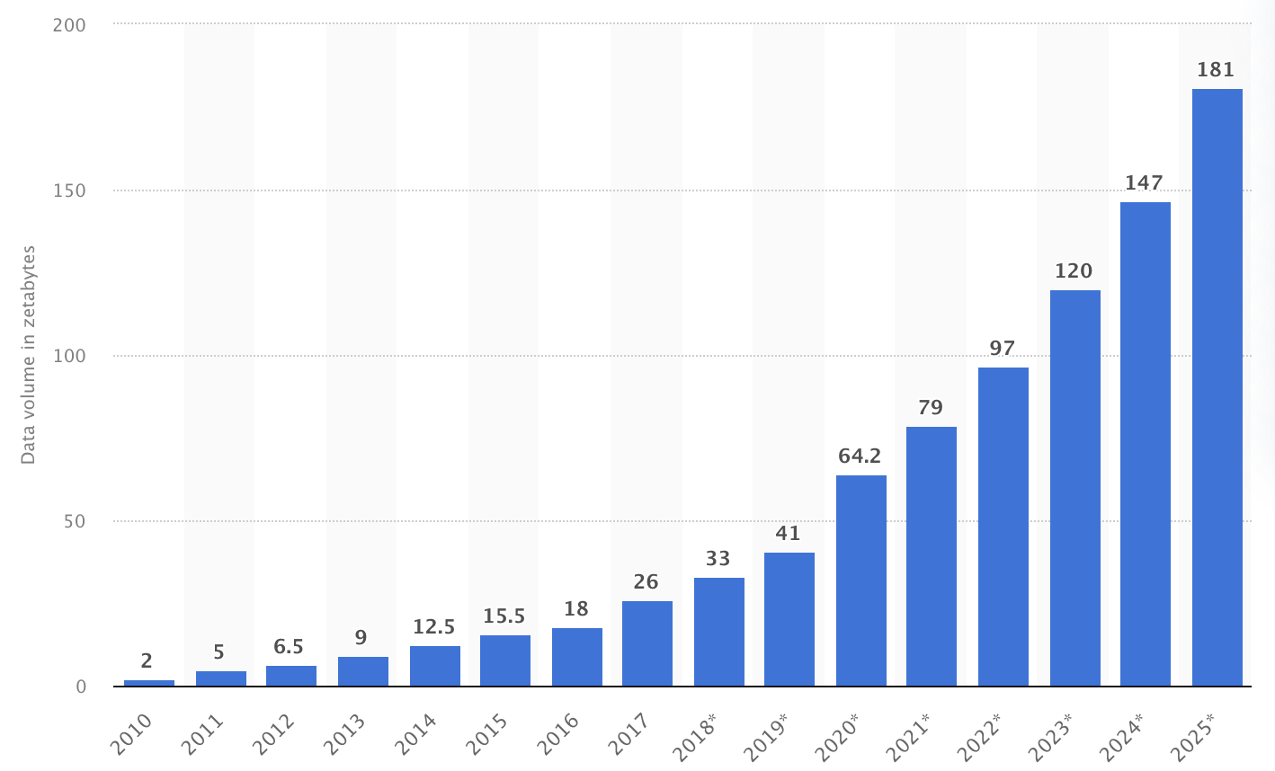
Introduction & Recap (1)
Tabular data
Most common data in model training
Increasingly High Demand for Data
Sensitivity to Privacy in Data
Generative models
GANS (CTAB-GAN +)
Diffusion (TabDDPM)
LLMs (GReaT)
Privacy Protection Method
k-Anonymity, l-Diversity, t-Closeness
DP (Differential Privacy)
Source: ResearchGate. Data from "Volume of data created, captured, copied, and consumed globally from 2010 to 2020" (Link: https://www.researchgate.net/figure/Volume-of-data-created-captured-copied-and-consumed-globally-from-2010-to-2020-and_fig1_373368180).
Notes:
As we can see, there is an exploding growing demand for data for all kinds of down stream work like model training, and Tabular data is one of the most common data format that widely used in all kinds of industries like health care and finance. With increasing demand for such data, privacy concerns have also grown due to some regulations like GDPR. So if we can have a method to protect the privacy of the original dataset but preserve the utility, it will highly facilitate the development of all industries. Based on this, we decided to go into the privacy protected data generation topic In the first three months, we have a fully look at those state-of-art data generation methods like Gan, diffusion, large language model based, flow model. We also play with those representatives for each model in tabular data generation. We have Ctab…… great for LLMs. And meanwhile we have some privacy protected methods like traditional k-anonymity and its extensions, also the most commonly used one Differential Privacy. We did some researches on how these privacy methods are embedded into these models to reach a balance.

Slide 4
Introduction & Recap (2)
Problem statement
LLMs based models present superior performance (Tabula)
Less attention paid to privacy concerns
Research Objectives
Develop a privacy-preserving version of Tabula
Evaluate the privacy-utility trade-offs
Apply and benchmark the model across multiple datasets
Notes:
And among all of them, the LLMs based methods behave a superior performance than others, but it doesn’t pay much attention to the privacy concern. Then we thought that’s a good direction to go, due to the limitation of computation resources, our focus is on the privacy concern. At that time, we selected Tabula as the representative due to its superior performance and its author Zilong Zhao, who creates CTAB-GAN + before, sounds more reliable. So my research objectives are in three aspects: as ppt

Slide 5
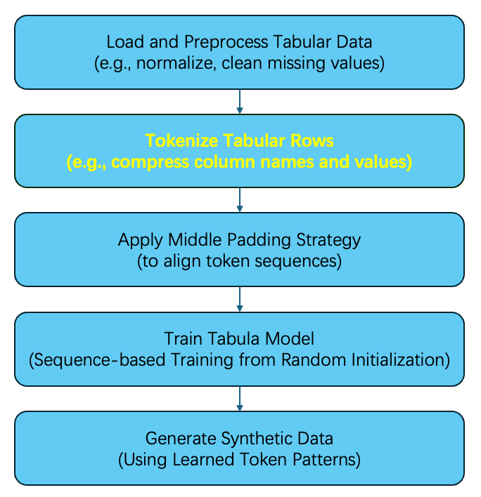
Methodology (1)
Tabula
Gender | Age | Income
Male | 28 | 5000
Female | 30 | 1000000
Conversion
Gender male, age 28, income 5000
Gender female, age 30, income 1000000
Tokenizer
[101, 4926, 4942, 1010, 2256, 2620, 1010, 3691, 3152, 102]
[101, 4926, 4013, 1010, 2256, 2382, 1010, 3691, 12837, 456 102]
Notes:
So before I present how I implement the privacy enhancement, I would like to give a brief introduction about Tabula. The mechanism is to convert the tabular data into a sentence and then tokenize the sentence into sequences and trains a language model as the flow shows. The interesting point of this model is to skip some connection words, in other models, the sentence should be gender is male, age is 28 like this. But it skips these words for token compression. This tokenization reduces the mismatch between tabular and natural language data.

Slide 6
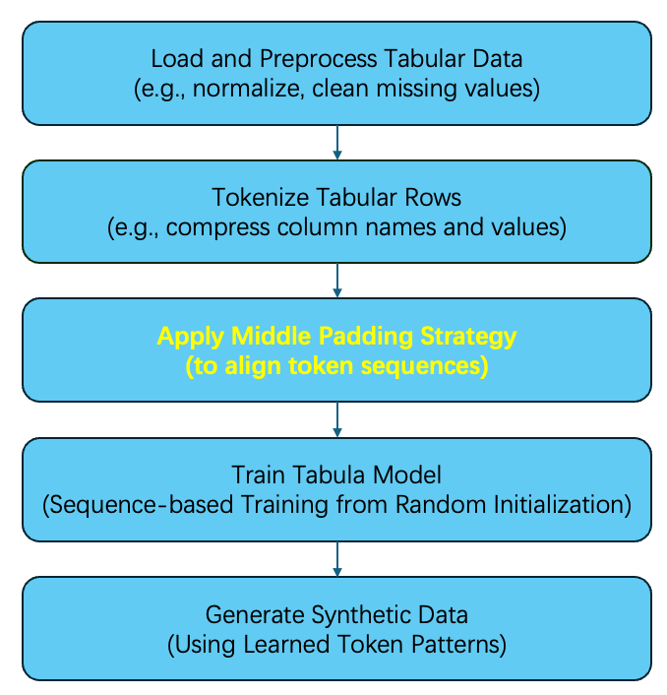
Methodology (2)
Tabula
[101, 4926, 4942, 1010, 2256, 2620, 1010, 3691, 3152, 102]
[101, 4926, 4013, 1010, 2256, 2382, 1010, 3691, 12837, 456 102]
Middle Padding
[101, 4926, 4942, 1010, 2256, 2620, 1010, 3691, Null, 3152, 102]
[101, 4926, 4013, 1010, 2256, 2382, 1010, 3691, 12837, 456 102]
Notes:
They also apply Middle-padding to ensure consistent feature alignment, enabling better feature dependency capture. We continue the example to explain how it works. As you can see, when we use the tokenizer to tokenize the sentence, we get two lists of tokens with different length because the large difference in amount of income. For the second row, we need two tokens to represent 1 million. So for avoiding the mismatch, we add one empty token 0 for the first row to make it the same length as the second. Similar to this, for each feature, we will find the word with the maximum number of tokens and then pad the whole column to make them the same length. So for all rows, they are still in the same length after tokenization. 加一个框把这个选中，把0改成None

Slide 7
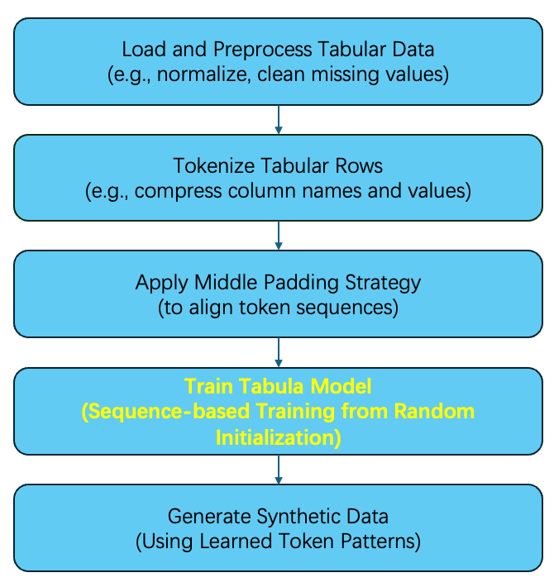

Methodology （3）
Tabula
Notes:
After we make all tokens ready, it comes to the model training process. Here is also the key finding of Tabula Thesis, it declares that the random initialized llm model can get e better performance than a pre-trained model with fixed weights. In our midterm presentation, we also make some experiments on this and the result fits the expectation.
In this step, it’s also where I did my implementation, I tried to enhance the privacy by adding DP-SGD into the Tabula.

Slide 8
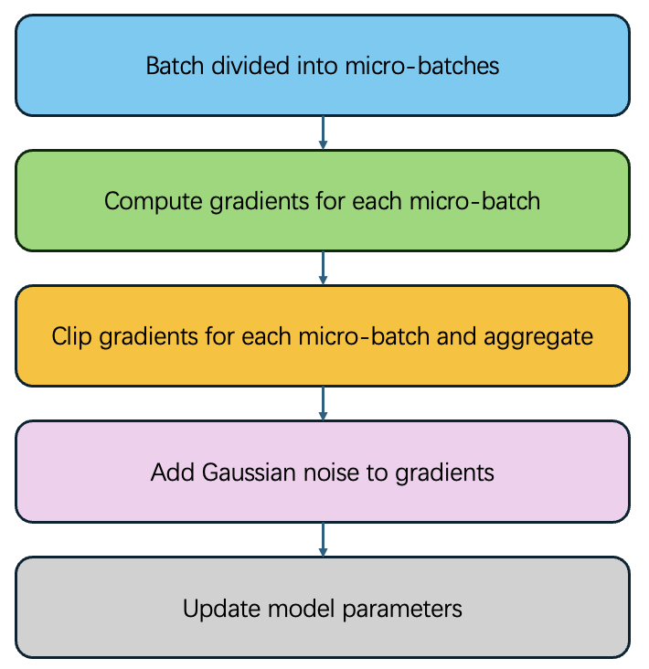
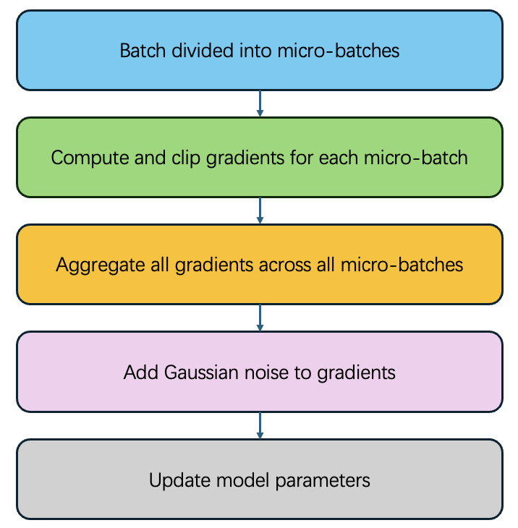
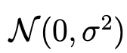
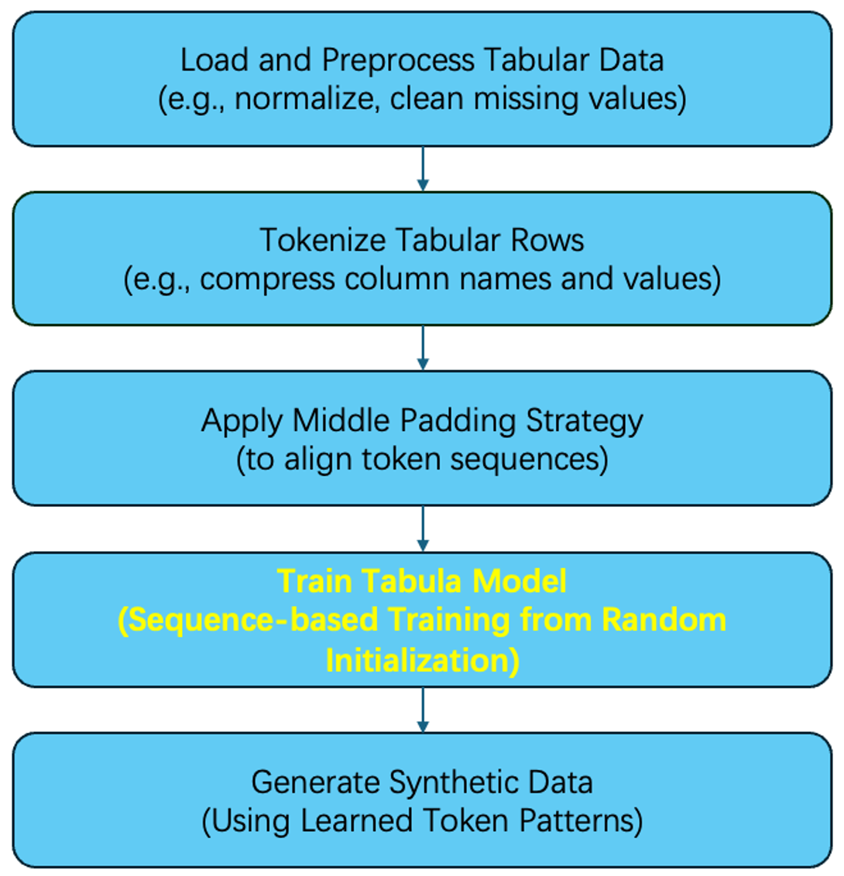
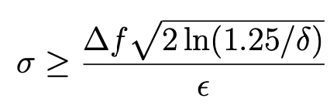
Methodology （4）
Privacy enhancement methods ---- DP-SGD
Gaussian noise:
Differential Privacy:
Limited influence of individual data point
Inherently privacy-preserving
Easy control of noise
Notes:
DP-SGD (Differential Private– Stochastic Gradient Descend) is an extension of the traditional gradient descent algorithm, designed to ensure differential privacy during model training. It protects sensitive data by adding noise directly to the model gradients, ensuring that the contribution of any single data point remains untraceable.”
“In our implementation, we break down the training batch into smaller micro-batches. For each micro-batch, we calculate the gradients and clip their values to limit the influence of individual data points. These gradients are then accumulated across all micro-batches.”
“Clipping ensures that the gradient contributions of any single data point are bounded. This step is critical because it standardizes the scale of gradients, enabling effective noise addition in the next step.”
“After processing all micro-batches, we add Gaussian noise to the accumulated gradients. The amount of noise is determined by a key parameter, σ\sigmaσ, which is the noise multiplier, higher sigma leads to stronger privacy
“Finally, these noisy gradients are used to update the model parameters, ensuring that the training process adheres to differential privacy guarantees
Compared to the method that directly add the noise to the synthetic dataset, this method is more tailored for each dataset according to their distribution during the training process, so it’s inherently privacy-preserving. Also it’s easier to control the noise added to the model to control the privacy budget by controlling the value of noise multiplier.

Slide 9
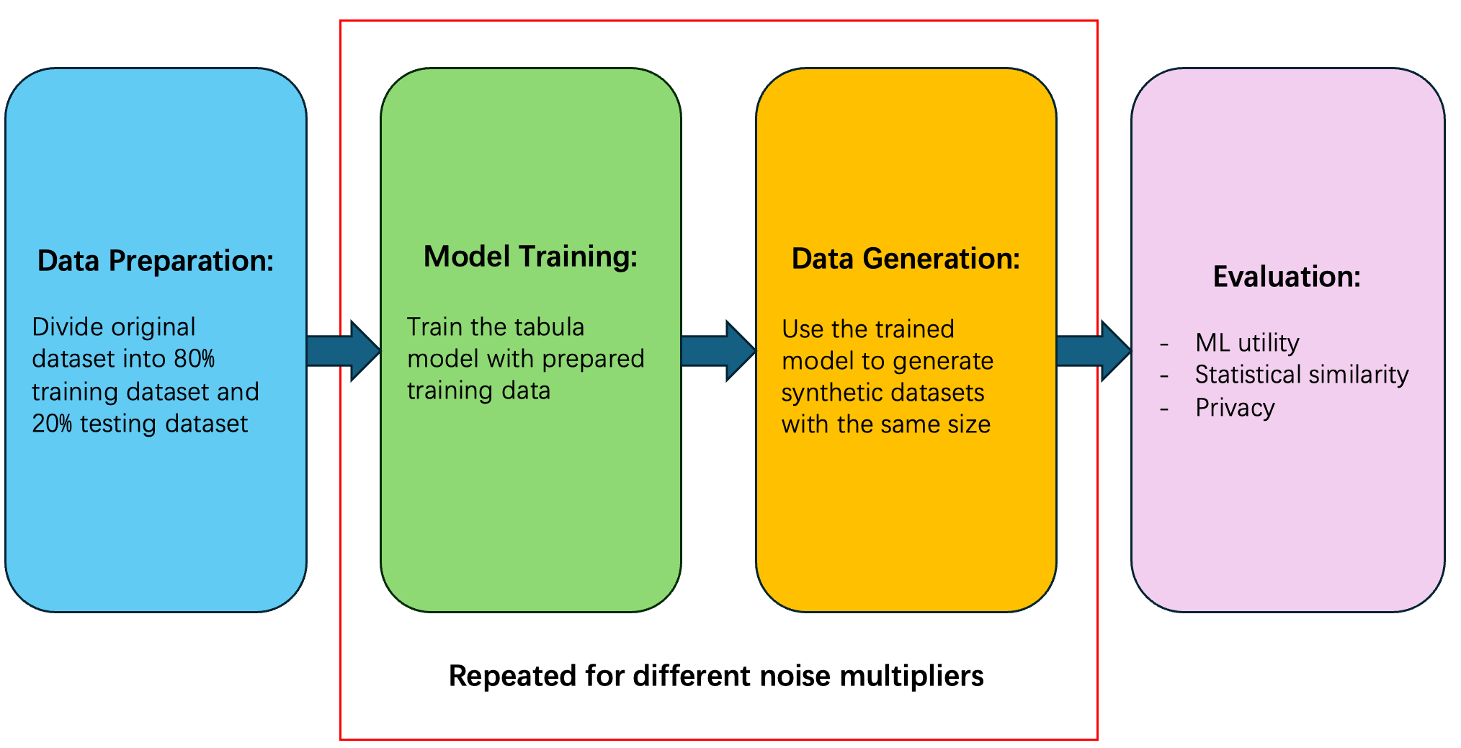
Experiments
Experiment Process
Notes:
Then I will start to explain my experiment pipeline and the evaluation on those results. As you can see, our pipeline is :

Slide 10
Evaluation (1)
Machine Learning Utility metrics
MAPE (Mean Average percentage Error) for regression dataset
LinearRegression, Ridge, Lasso, and BayesianRidge
F1-score and accuracy for classification dataset
RandomForestClassifier and GradientBoostingClassifier
Statistical Utility metrics
Correlation
JS (Jensen-Shannon Divergence)
Mean, Median, variance
Privacy metrics
DCR (Differential Correlation Ratio)
NNDR (Nearest Neighbor Distance Ratio)
NNAA (Neural Network Adversarial Accuracy)
Notes:
So for the above three kinds of evaluation metrics, we take the details as follows: ML utility metrics like MAPE and F1-score assess predictive performance are obtained by the average results on different common models. Statistical metrics evaluate data similarity, and privacy metrics, including NNDR and DCR, measure protection against re-identification, they are from the evaluation framework hat created by Weijie and Karoline, who is not here. But I really thank them a lot to make my life easier.

Slide 11
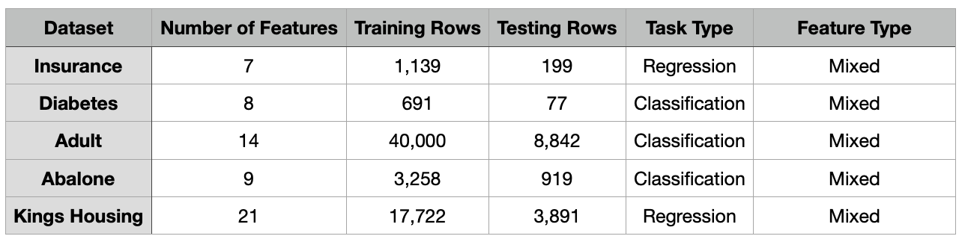
Evaluation (2)
Datasets
Outliers （Stopping Criteria）
Three categories of synthetic datasets
Unprocessed synthetic dataset
Synthetic dataset with outliers replaced by median
Synthetic dataset with outliers removed
Notes:
Before I show you the results of my experiments, I will do a brief introduction about all datasets and some processing process to evaluate the results. The same series of experiments are conducted on five different datasets that vary in size, feature number and task type. And according to my observation, I found there exist some outliers that generated during the sampling stage, it occurs due to the noise in tail part of the gaussian distribution that might be relatively large to produce the outlier, which is due to the mechanism and can hardly be avoided. And I define the outlier as the min_value – std or max_value + std. I took two methods to deal with these outliers, one is to replace it with the median in original dataset and the other is to remove it from synthetic dataset. So for each synthetic dataset, we will do the evaluation for three times including the unprocessed one and two processed ones.

Slide 12
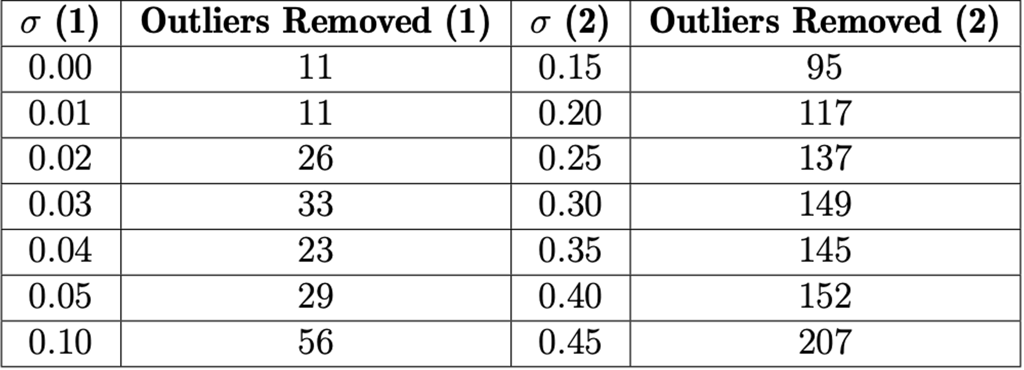
Evaluation (3)
Number of Outliers （Diabetes Dataset)
The amount of outliers increases as noise increases
Notes:
“This slide illustrates the impact of noise on the number of outliers generated. As you can see, the number of outliers increases with the noise multiplier, which fullfills the expectation. With more noise added, the synthetic dataset can be somehow affected

Slide 13
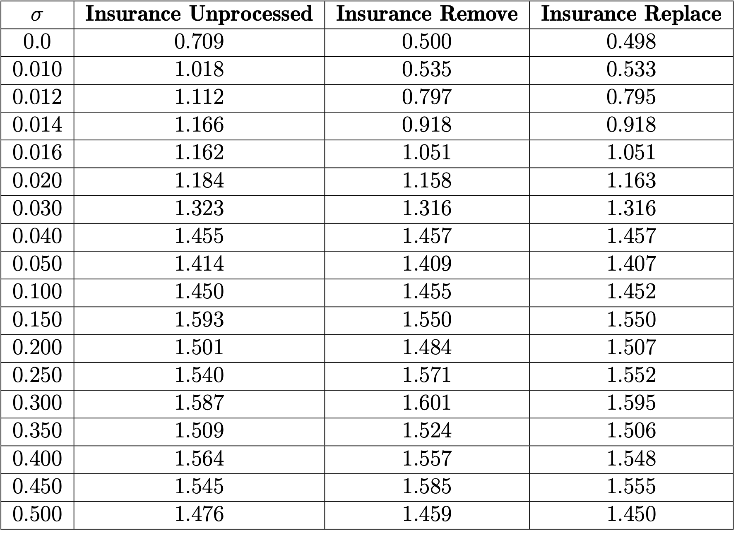
Evaluation (4)
Machine Learning Utility (Insurance Dataset – MAPE )
Outliers in weaker noise impact more
When noise strength goes higher, the outlier is not obvious
Both processed datasets show similar trend
Notes:
“Here, you can see the performance metrics for unprocessed, replaced, and removed datasets. The processed dataset shows better performance than the unprocessed one and two processed datasets follow the same trend in performance. Especially when the noise is at a low level, the outlier highly affect the utility of synthetic dataset, which makes sense. Because when the noise is weak, the distribution will be quite similar to the original one due to the superior performance of Tabula, then the outlier will make the feature distribution away from the original distribution.

Slide 14
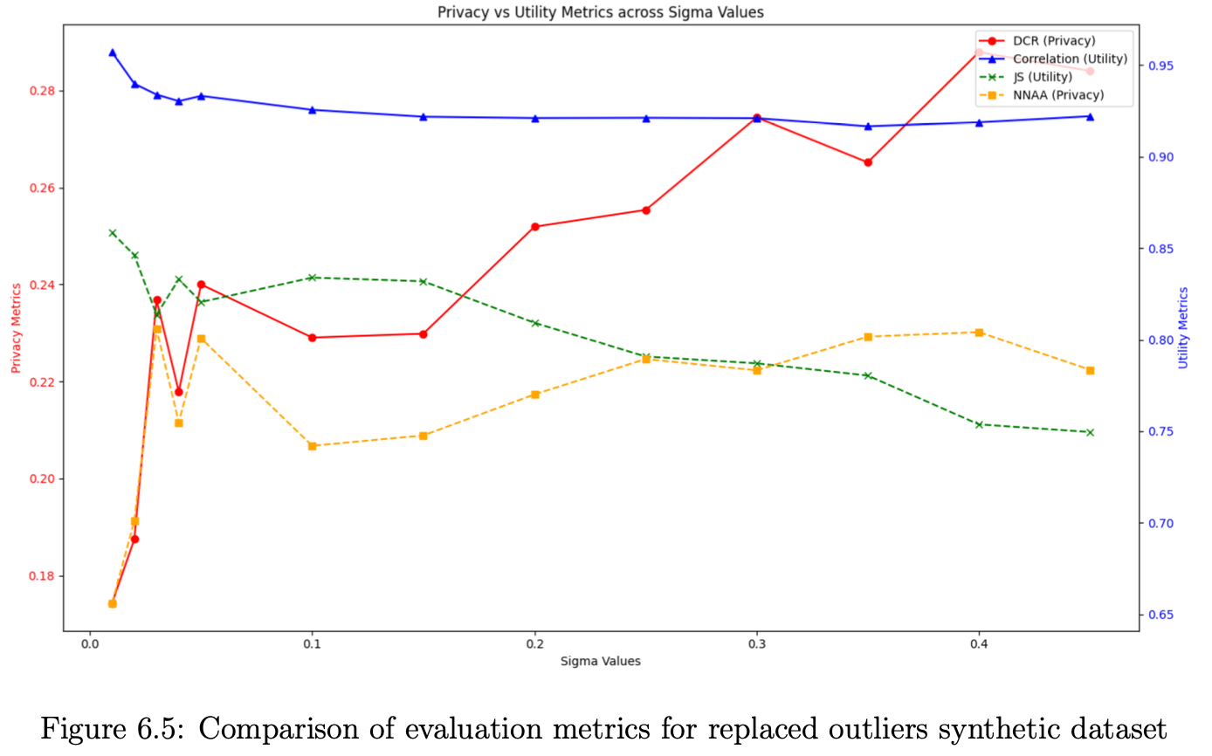
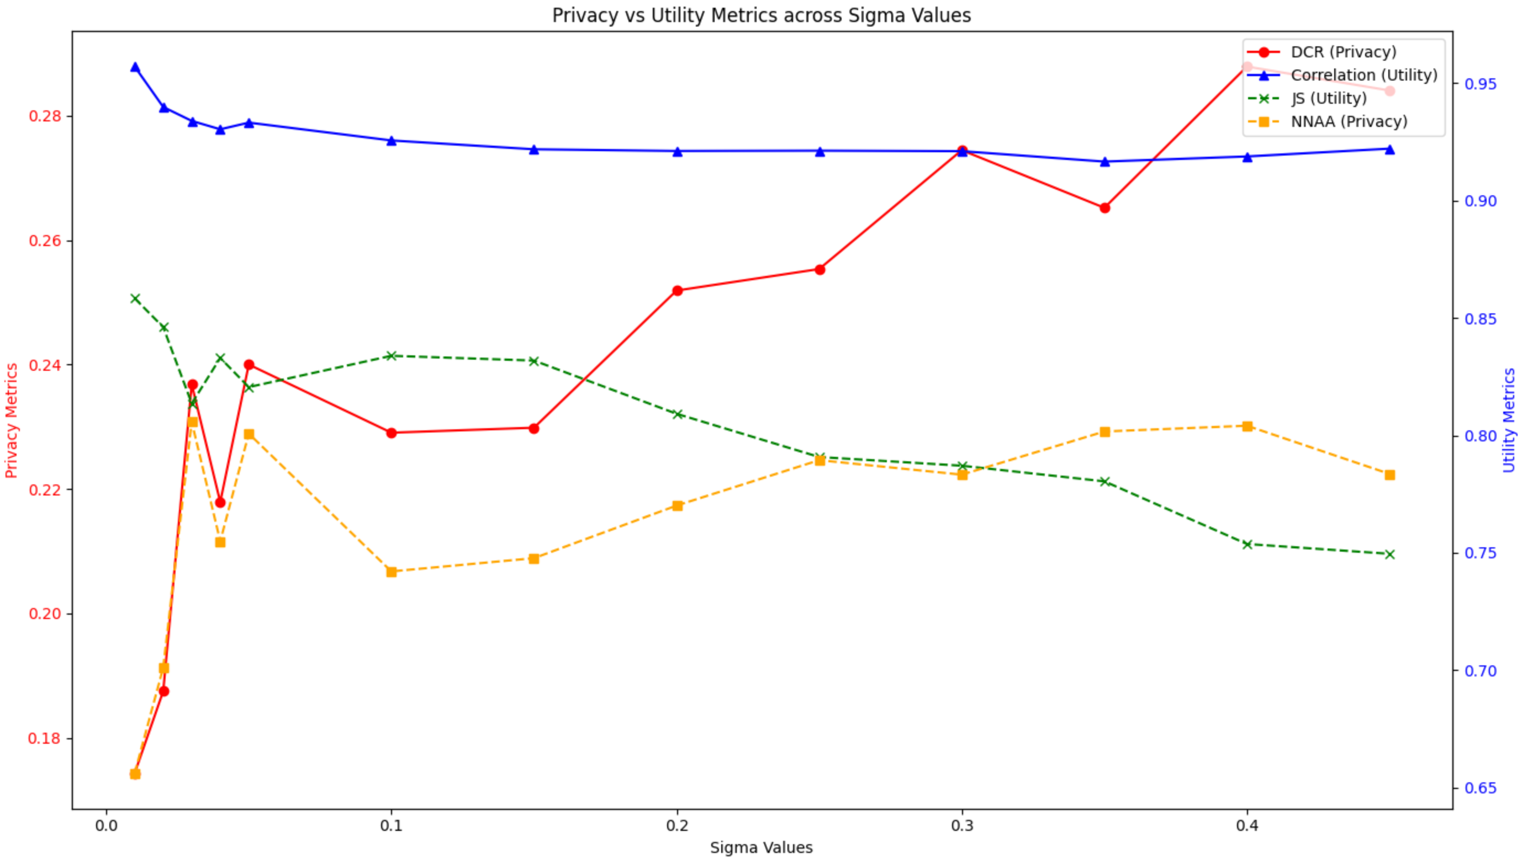
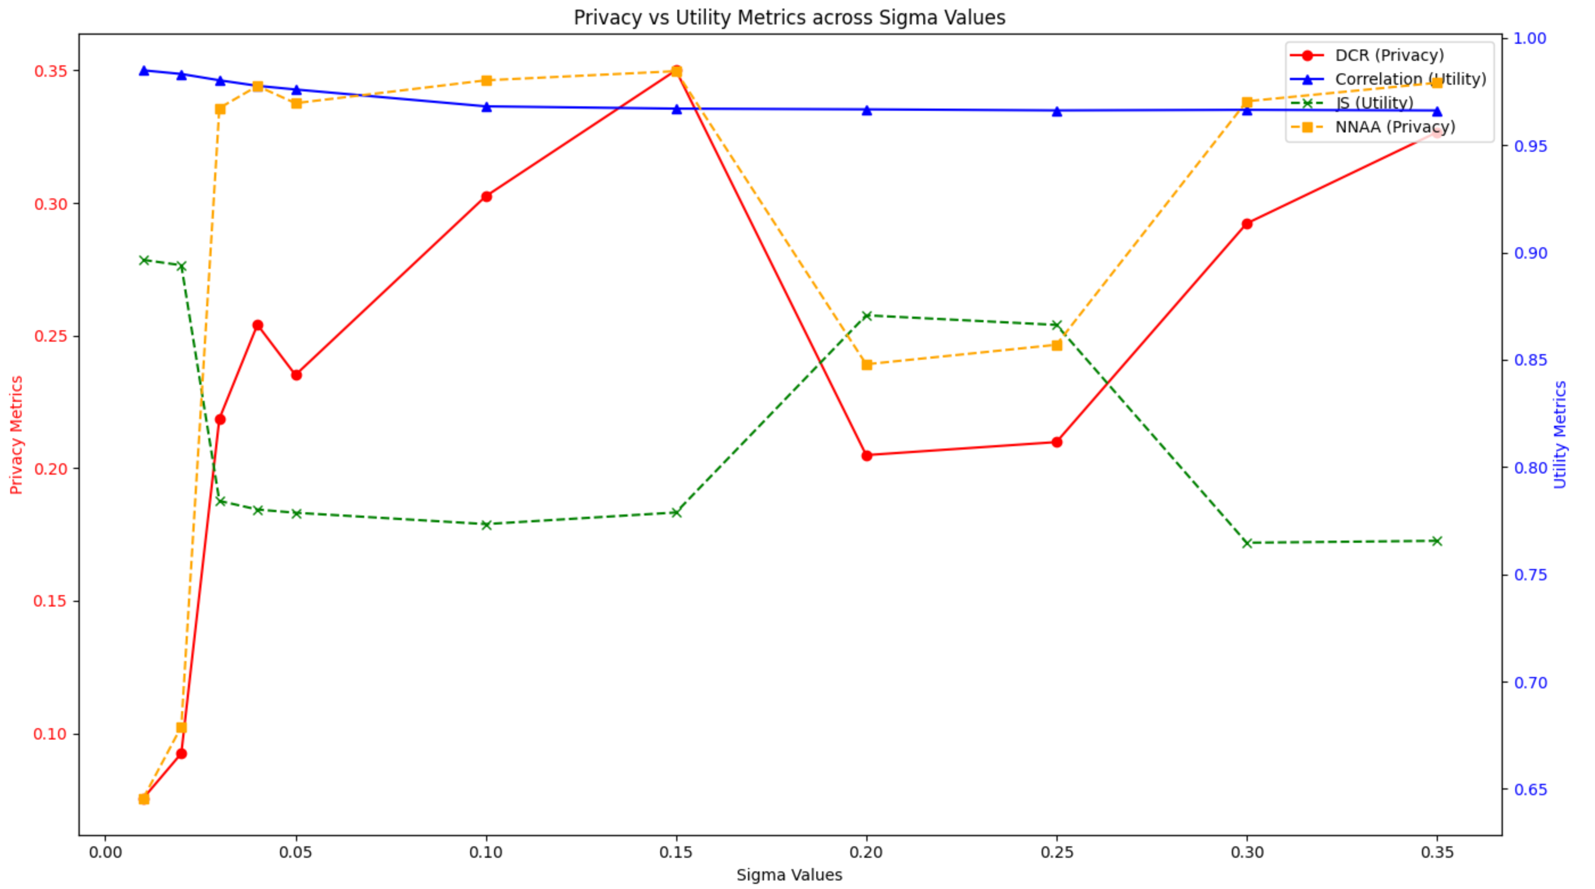
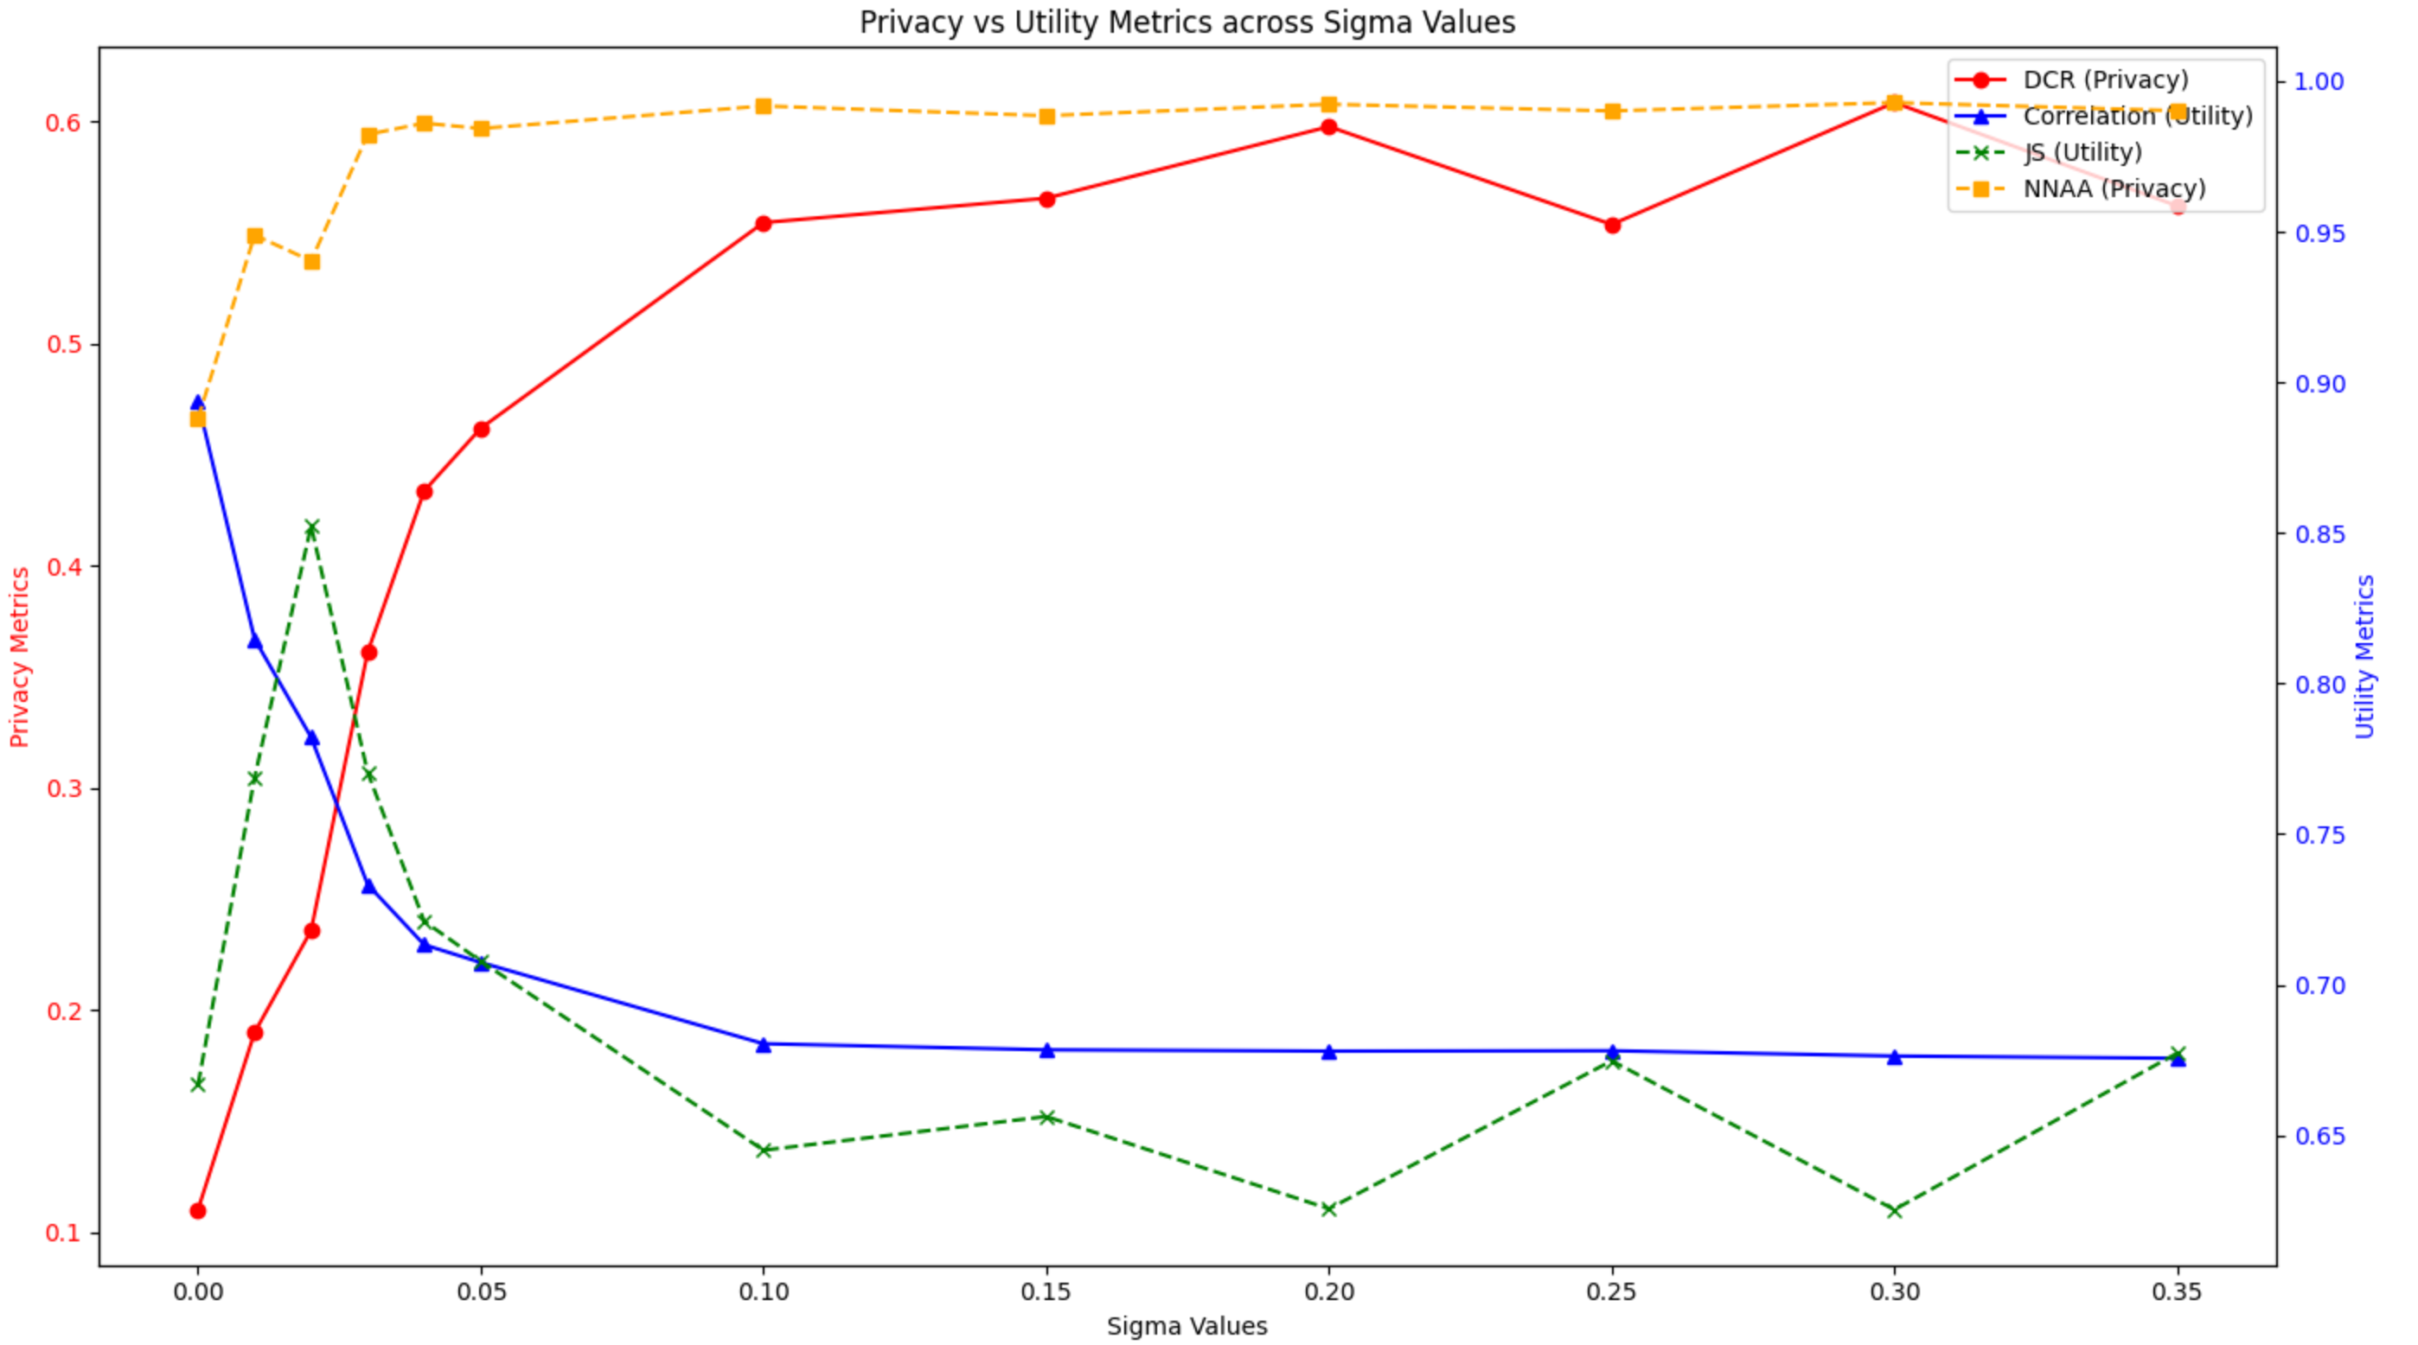
Evaluation (5)
Statistical utility and privacy （Replaced)
DCR value
Other value
DCR value
Other value
Insurance
Diabetes
Other value
Other value
DCR value
DCR value
Abalone
Adults

Slide 15
Findings & Discussion (1)
Evaluation overview
The number of outliers increases proportionally with the strength of noise added during training.
Outliers in weaker noise scenarios show higher impact on synthetic datasets distribution
The DP-Tabula gains much higher privacy enhancement while losing moderate utility
Notes:
The above is just an example of the evaluation pipeline for each dataset
In this discussion, we focus on the observed trends and insights derived from evaluating the DP-Tabula model with varying noise strengths.
First, we observe that the number of outliers increases proportionally with the strength of noise added during training. This is expected as higher noise disrupts the data generation process, causing deviations in the generated data.
To maintain a balance between utility and privacy, we defined a stopping criterion. Specifically, we halt noise addition once outliers reach 10% of the total dataset. This threshold ensures that the synthetic data remains useful while achieving a reasonable level of privacy protection.
Another key observation is that outliers in weaker noise conditions have a much higher impact on the synthetic dataset’s distribution.
despite the added noise, the DP-Tabula model demonstrates significant privacy enhancement with only a limited loss in utility. This highlights the effectiveness of our approach in balancing the trade-off between privacy and usability

Slide 16
Findings & Discussion (2)
Sensitivity to dataset properties
Dataset Size:
Smaller datasets are more sensitive to noise, leading to a rapid decline in utility metrics.
Insufficient data can cause noise to disrupt the ability to approximate distributions.
Number of Features:
Datasets with more features struggle to maintain meaningful distributions.
Longer tokenized sequences exacerbate the impact of noise, making learning ineffective.
Categorical Feature Complexity:
Datasets with fewer categories in categorical features perform significantly better.
A higher number of categories complicates the generation process, reducing synthetic data quality.
Notes:
let's discuss the sensitivity of the DP-Tabula model to different dataset properties.
First, regarding dataset size: Smaller datasets are noticeably more sensitive to noise. This sensitivity leads to a rapid decline in utility metrics when stronger noise is introduced. The primary reason for this is the insufficient data points, which make it challenging for the model to learn meaningful distributions while under the influence of noise.
about the number of features. Datasets with more features often struggle to maintain meaningful distributions. This is because the tokenized sequences become significantly longer as the number of features increases. When noise is added to these longer sequences, it disrupts the structure, making learning ineffective. Essentially, the model fails to balance noise with meaningful signal in such complex scenarios
categorical feature complexity plays a key role. Datasets with fewer categories in categorical features tend to perform significantly better. However, as the number of categories increases, the generation process becomes more complicated, and this complexity reduces the quality of synthetic data

Slide 17
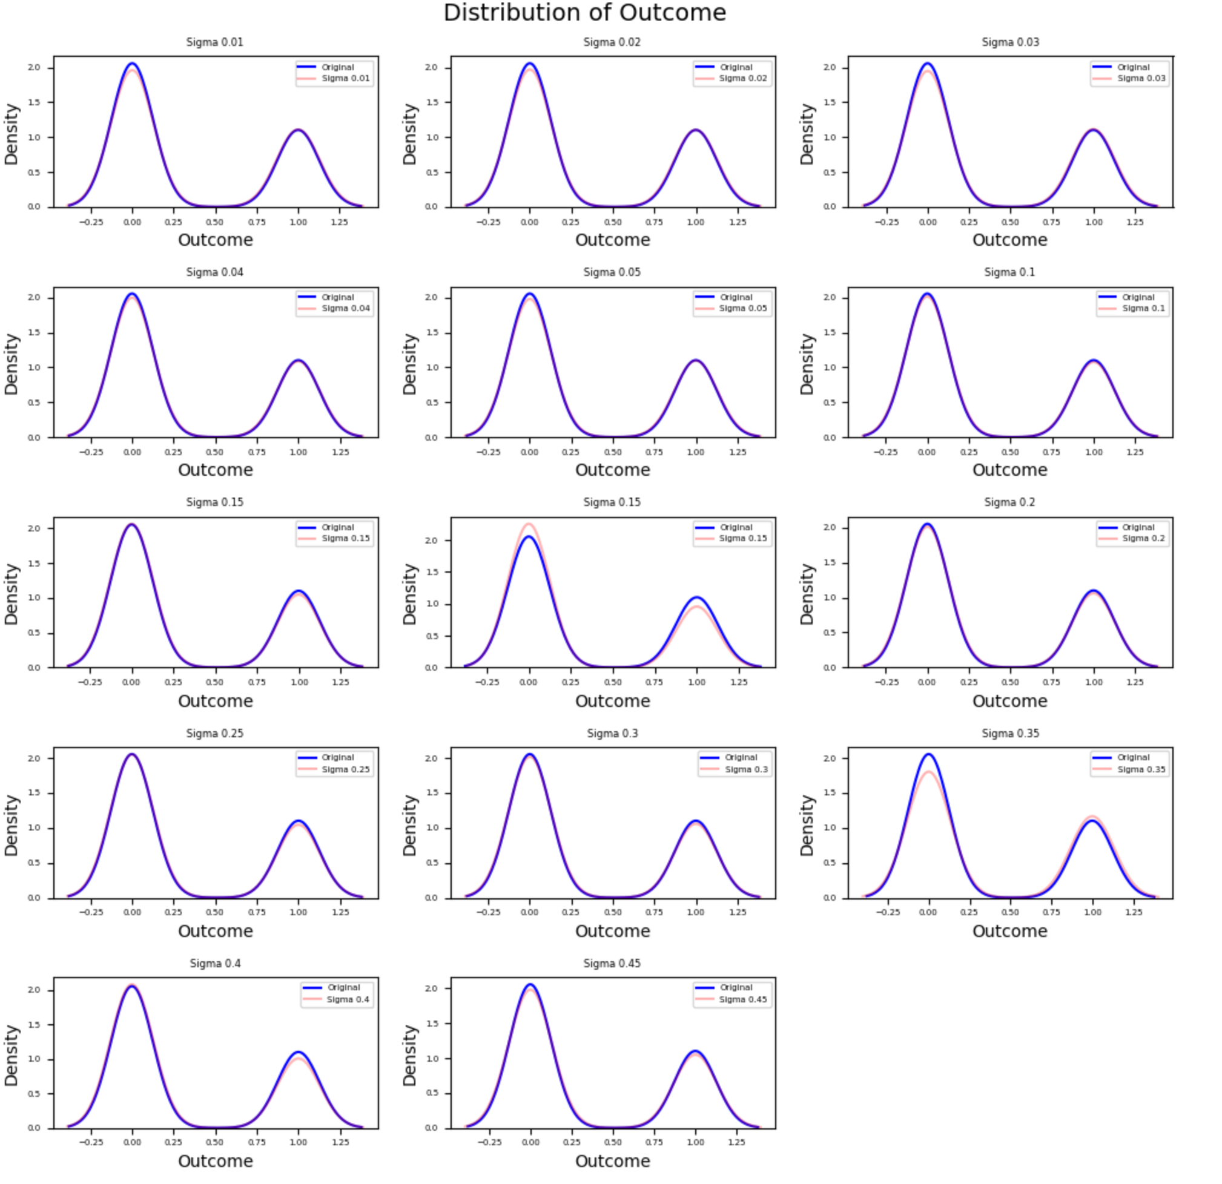
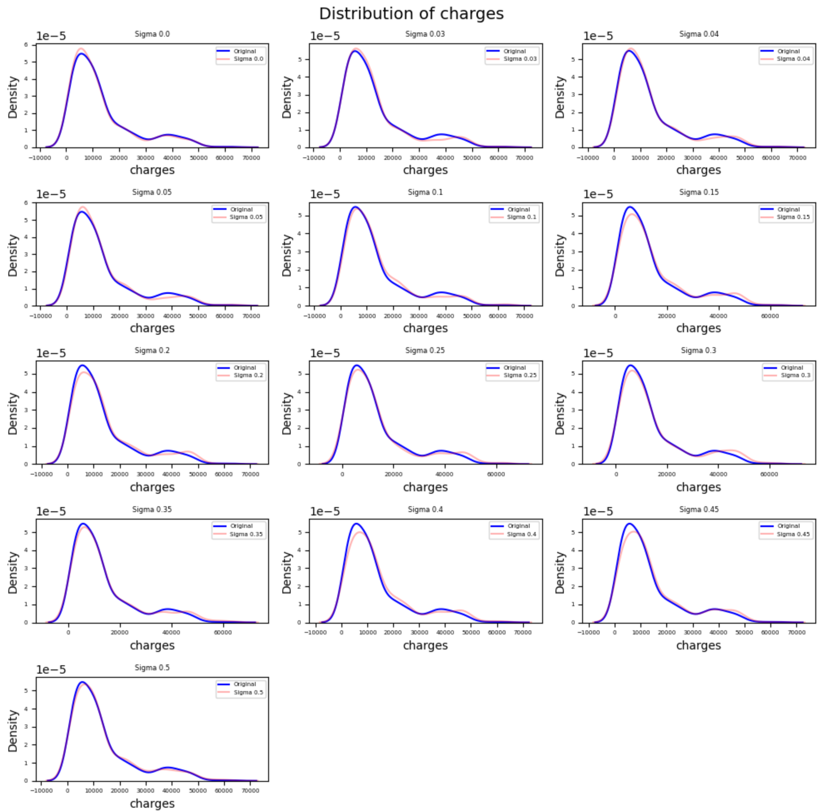
Findings & Discussion (3)
The order of feature can affect the performance
Diabetes
Diabetes
Insurance
Notes:
There is also one interesting finding that the order of feature matters in performance. For the evaluation, I also draw the distribution comparison between the synthetic datasets and original ones for each feature under different noise strength. As you can see here, these three features fit really well, almost identical, and all of them are the last feature, the last column for three datasets. So I am curious about why it happens, and we add another experiment set:

Slide 18
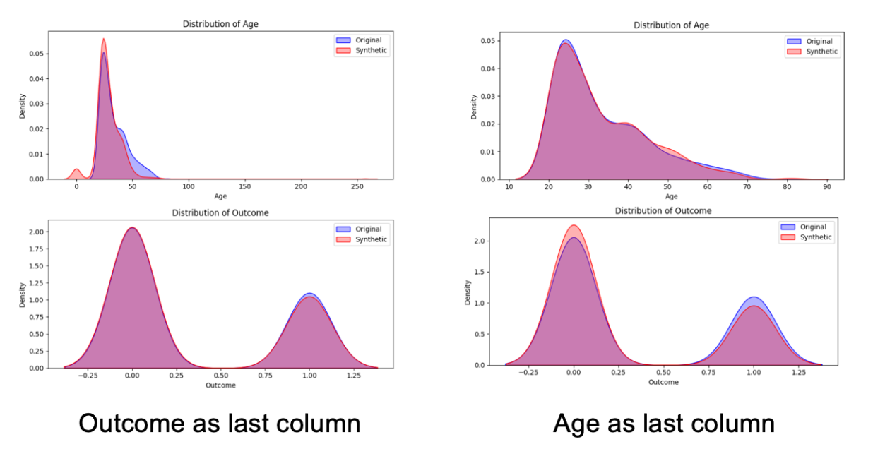
Findings & Discussion (4)
The order of feature can affect the performance
Notes:
I took an experiement on diabetes dataset, I trained an initial model first with the original dataset and generate a synthetic dataset and compare the distribution of the last two features, the result is as left. Then I trained an initial model with the new dataset that exchanges the order of last two columns and did the same. The result is as right. It’s obvious to see that the last feature fits better. This might be due to the mechanism of LLMs, which pays more attention to the beginning or the end of the sentence.

Slide 19
Conclusion & Future Work
Conclusion
The integration of DP-SGD in Tabula achieves a strong balance between utility and privacy.
The method adapts effectively to different datasets by tuning the noise multiplier, preserving synthetic data quality while enhancing privacy.
The approach demonstrates the potential of privacy-preserving techniques in LLM-based data generation.
Future Work
Extend evaluations to include more diverse datasets with varied structures and feature types.
Investigate advanced privacy-preserving methods tailored for LLM-based synthetic data generation.
Notes:
In conclusion, the incorporation of DP-SGD into Tabula has proven to be an effective strategy for balancing privacy and utility. By fine-tuning the noise multiplier for each dataset, the model maintains high-quality synthetic data generation while ensuring robust privacy protection. This outcome highlights the potential of privacy-enhancing techniques in LLM-based models.
Looking ahead, there is room for improvement. Future work should focus on evaluating the method across more diverse datasets with varying complexities to assess its generalizability. Additionally, exploring advanced or hybrid privacy-preserving mechanisms tailored for LLM-based methods could further enhance the balance between utility and privacy.

Slide 20
Thank You for Your Attention!
Q & A

